Slide 1

Association Rule Mining
Apriori Algorithm

Slide 2
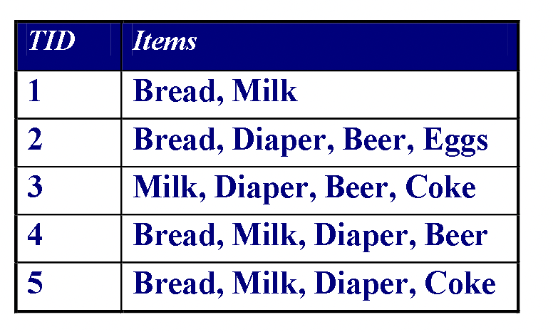
Association Rule Mining
Given a set of transactions, find combinations of items (itemsets) that occur frequently
Market-Basket transactions Example of Association Rules {Diaper} → {Beer},
{Milk, Bread} → {Eggs, Coke},
{Beer, Bread} → {Milk}
Implication means co- occurrence, not causality!

Slide 3
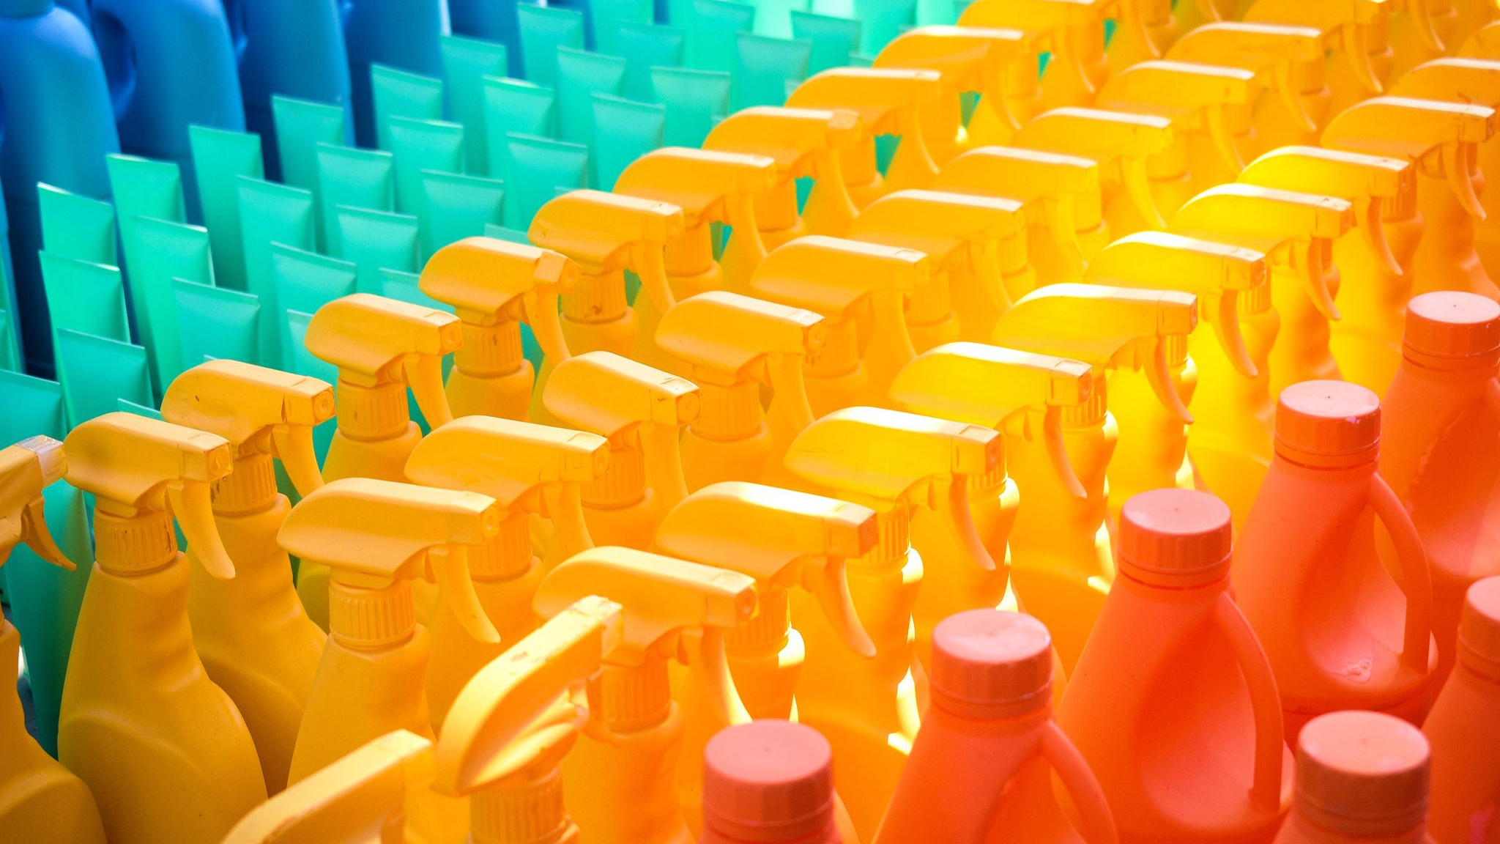
Applications
Items = products; baskets = sets of products someone bought in one trip to the store.
Example application: given that many people buy beer and diapers together:
E.g : Run a sale on diapers; raise price of beer.
Only useful if many buy diapers & beer.

Slide 4
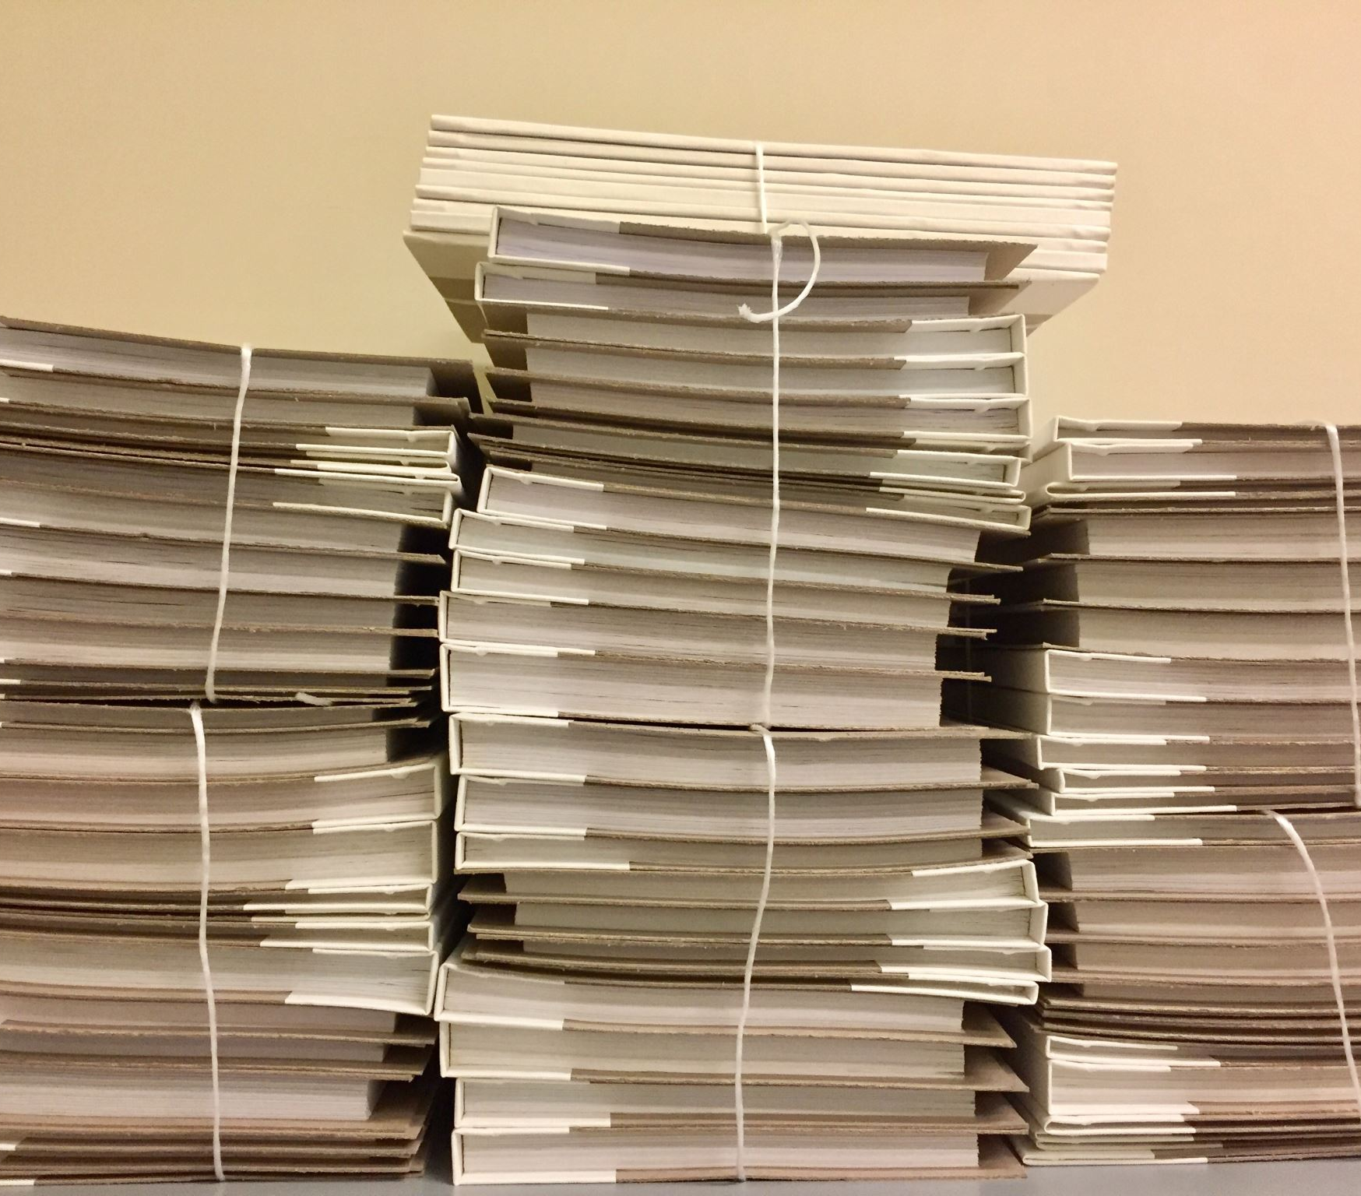
Applications
Baskets = sentences; Items = documents containing those sentences
Items that appear together too often could represent plagiarism
Notice items do not have to be “in” baskets

Slide 5
Applications
Baskets = patients; Items = drugs/medicine & side-effects
Has been used to detect combinations of drugs that result in particular side-effects
But requires extension: Absence of an item needs to be observed as well as presence

Slide 6
Definition: Frequent Itemset
Itemset
A collection of one or more items
Example: {Milk, Bread, Diaper}
k-itemset
An itemset that contains k items
Support count (σ)
Frequency of occurrence of an itemset
E.g., σ({Milk, Bread, Diaper}) = 2
Support
Fraction of transactions that contain an itemset
E.g., s({Milk, Bread, Diaper}) = 2/5
Frequent Itemset
An itemset whose support is greater than or equal to a minsup threshold

Slide 7

Mining Frequent Itemsets task
Input: A set of transactions T, over a set of items I
Output: All itemsets with items in I having support ≥ minsup threshold
Problem parameters:
- N = |T|: number of transactions
- d = |I|: number of (distinct) items
- w: max width of a transaction
- Number of possible itemsets?
Scale of the problem:
- WalMart sells 100,000 items and can store billions of baskets.
- The Web has billions of words and many billions of pages.

Slide 8
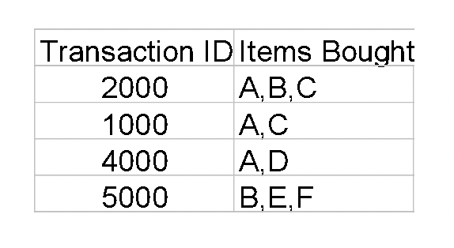
Definition: Association Rule
Let D be database of transactions
e.g.:
Let I be the set of items that appear in the database, e.g., I={A,B,C,D,E,F}
A rule is defined by X ⇒ Y, where X⊂I, Y⊂I, and X∩Y=∅
e.g.: {B,C} ⇒ {E} is a rule

Slide 9
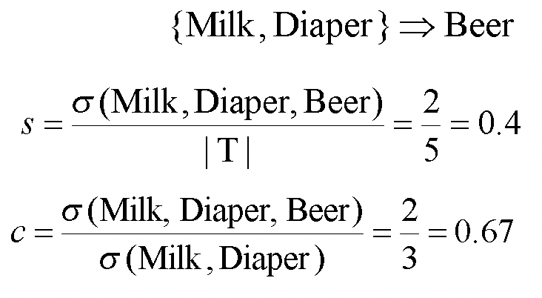
Definition: Association Rule
Association Rule
An implication expression of the form X → Y, where X and Y are itemsets
Example: {Milk, Diaper} → {Beer}
Rule Evaluation Metrics
Support (s): Fraction of transactions that contain both X and Y
Confidence (c): Measures how often items in Y appear in
transactions that contain X

Slide 10
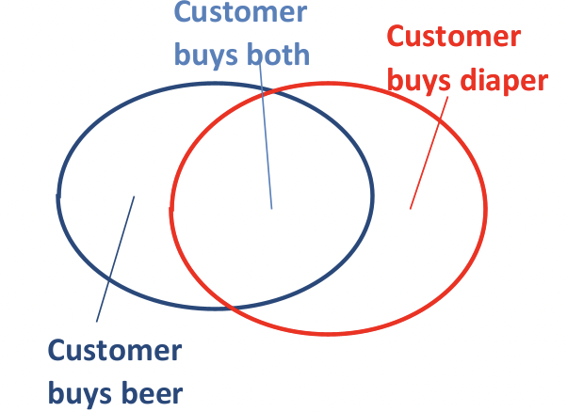
Rule Measures: Support and Confidence
Find all the rules X ⇒ Y with minimum confidence and support
- support, s, probability that a transaction
contains {X ∪ Y}
- confidence, c, conditional probability
that a transaction having X also
contains Y
Let minimum support 50%,
and minimum confidence
50%, we have
A ⇒ C (50%, 66.6%)
C ⇒ A (50%, 100%)

Slide 11
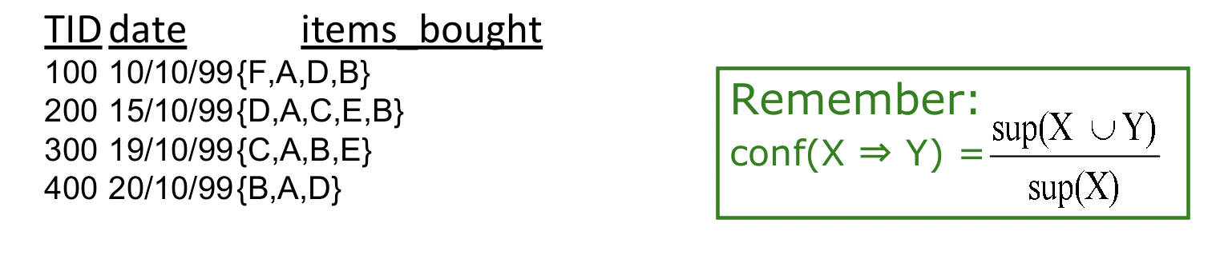
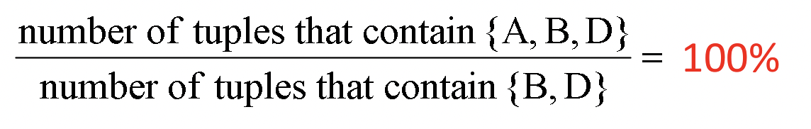
Example
What is the support and confidence of the rule: {B,D} ⇒ {A}
Support:
Percentage of tuples that contain {A,B,D} = 75%
Confidence:

Slide 12
Association Rule Mining Task
Given a set of transactions T, the goal of association rule mining is to find all rules having
support ≥ minsup threshold
confidence ≥ minconf threshold
Brute-force approach:
List all possible association rules
Compute the support and confidence for each rule
Prune rules that fail the minsup and minconf thresholds
⇒ Computationally prohibitive!

Slide 13
Mining Association Rules
Example of Rules:
{Milk, Diaper} → {Beer} (s=0.4, c=0.67)
{Milk, Beer} → {Diaper} (s=0.4, c=1.0)
{Diaper, Beer} → {Milk} (s=0.4, c=0.67)
{Beer} → {Milk, Diaper} (s=0.4, c=0.67)
{Diaper} → {Milk, Beer} (s=0.4, c=0.5)
{Milk} → {Diaper, Beer} (s=0.4, c=0.5)
Observations:
All the above rules are binary partitions of the same itemset: {Milk, Diaper, Beer}
Rules originating from the same itemset have identical support but can have different confidence
Thus, we may decouple the support and confidence requirements

Slide 14
Mining Association Rules
Two-step approach:
Frequent Itemset Generation: Generate all itemsets whose support ≥ minsup
Rule Generation: Generate high confidence rules from each frequent itemset, where each rule is a binary partitioning of a frequent itemset
Frequent itemset generation is still computationally expensive

Slide 15
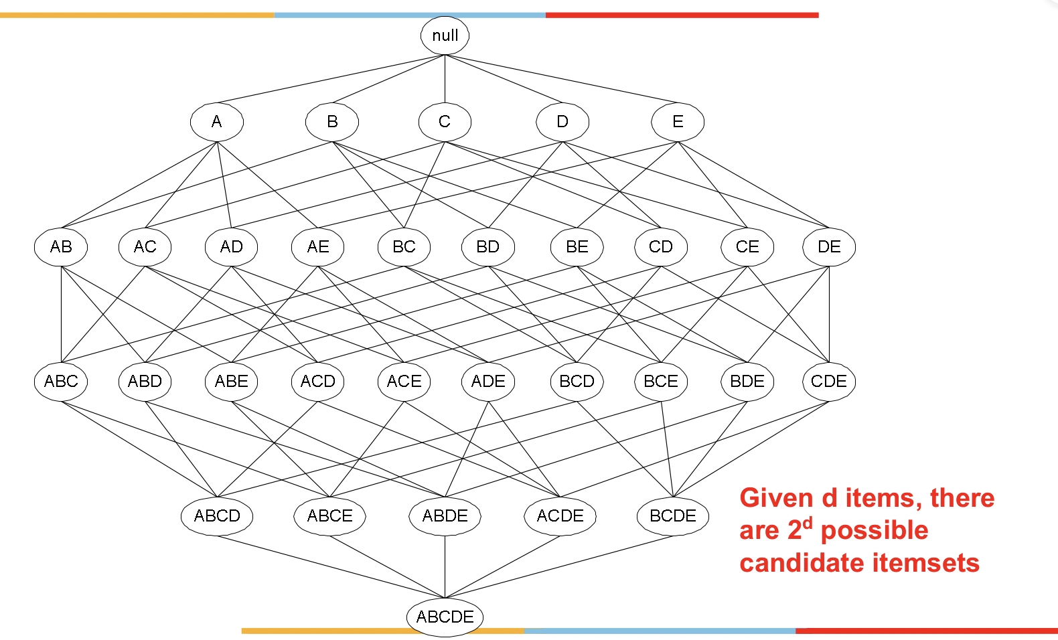
Frequent Itemset Generation

Slide 16
When is the task sensible and feasible?
If minsup = 0, then all subsets of I will be frequent and thus the size of the collection will be very large
This summary is very large (maybe larger than the
original input) and thus not interesting
The task of finding all frequent sets is interesting typically
only for relatively large values of minsup

Slide 17
Brute-force algorithm for finding all frequent itemsets?
Generate all possible itemsets (lattice of itemsets)‏
- Start with 1-itemsets, 2-itemsets,...,d-itemsets
Compute the frequency of each itemset from the data
- Count in how many transactions each itemset occurs
If the support of an itemset is above minsup report it as a frequent itemset.

Slide 18
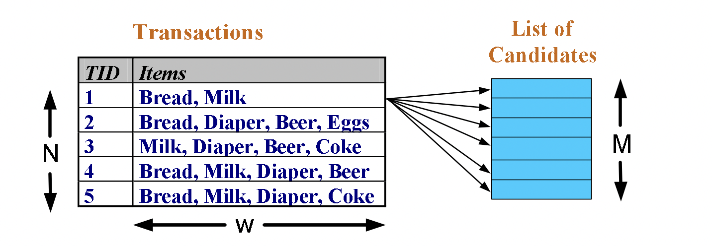
Brute-force approach for finding all frequent itemsets
Complexity?
Match every candidate against each transaction
For M candidates and N transactions, the complexity is~ O(MNw) => Expensive since M = 2d !!!

Slide 19
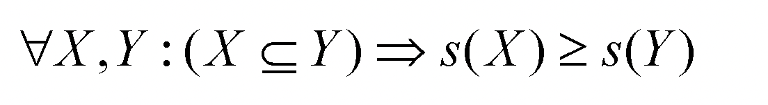
Apriori principle
Apriori principle (Main observation):
If an itemset is frequent, then all its subsets must also be frequent
Apriori principle holds due to the following property of the support measure:
The support of an itemset never exceeds the support of its subsets
This is known as the anti-monotone property of support acting on the subsets of the itemsets.

Slide 20
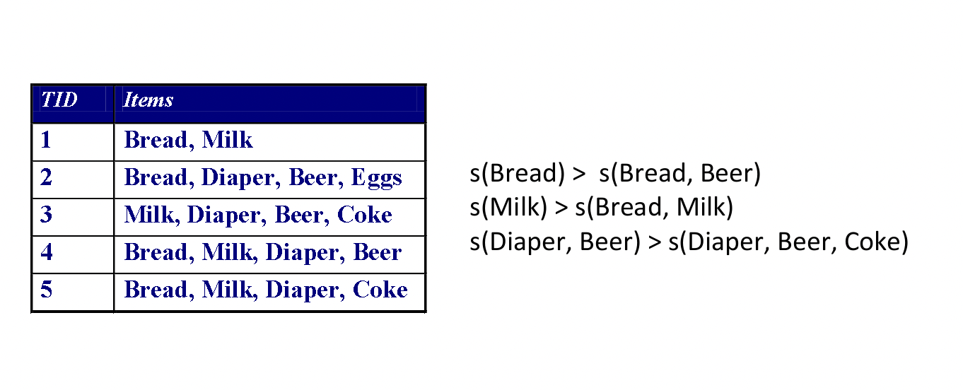
Example

Slide 21
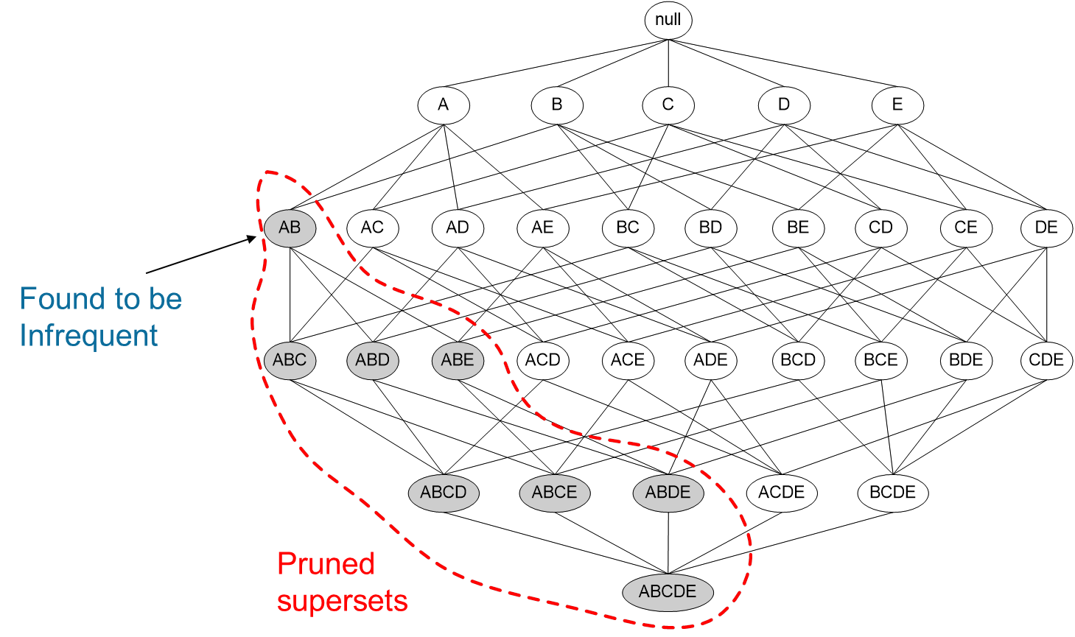
Illustrating the Apriori principle

Slide 22
Mining Frequent Itemsets: The Key Step
Find the frequent itemsets: the sets of items that have minimum support
- A subset of a frequent itemset must also be a frequent itemset
- If {AB} is a frequent itemset, both {A} and {B} should be frequent itemsets
- Iteratively find frequent itemsets with cardinality from 1 to m (m-itemset): Use frequent k-itemsets to explore (k+1)-itemsets.
Use the frequent itemsets to generate association rules.

Slide 23
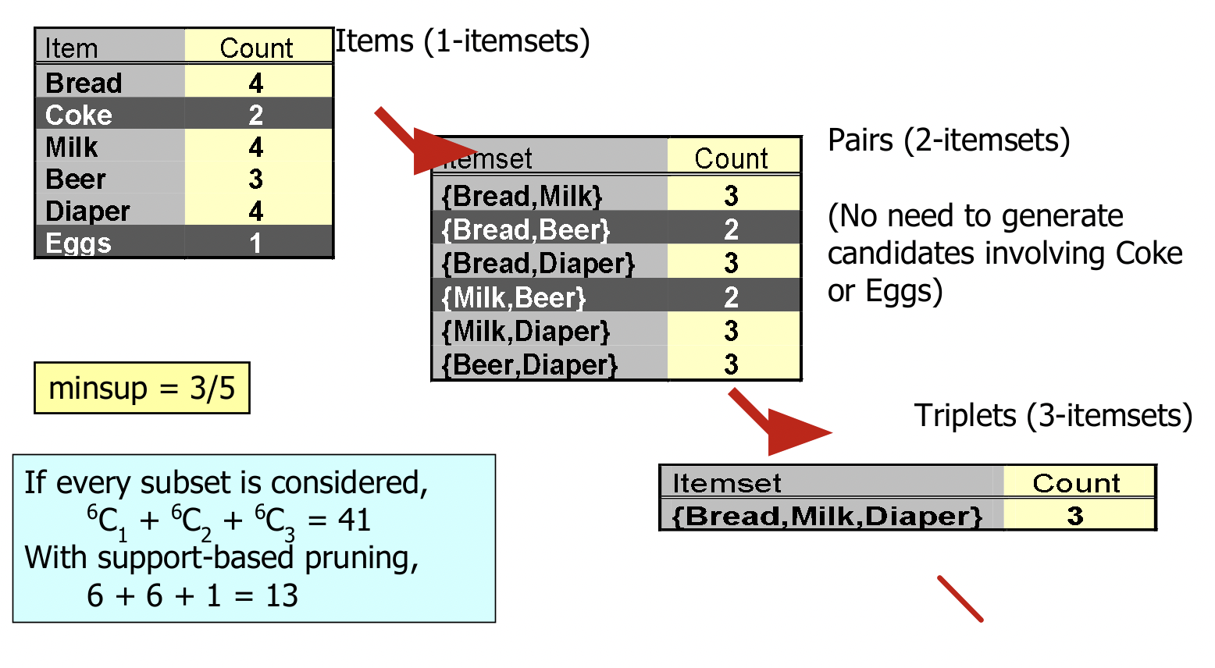
Illustrating the Apriori principle

Slide 24
Exploiting the Apriori principle
Find frequent 1-items and put them to L_{k} (k=1)
Use L_{k} to generate a collection of candidate itemsets C_{k+1} with size (k+1)
Scan the database to find which itemsets in C_{k+1} are frequent and put them into L_{k+1}
If L_{k+1} is not empty
k=k+1
GOTO 2

Slide 25
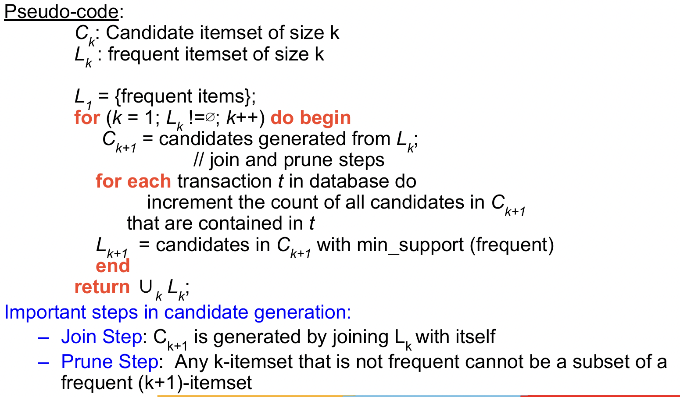
The Apriori algorithm

Slide 26
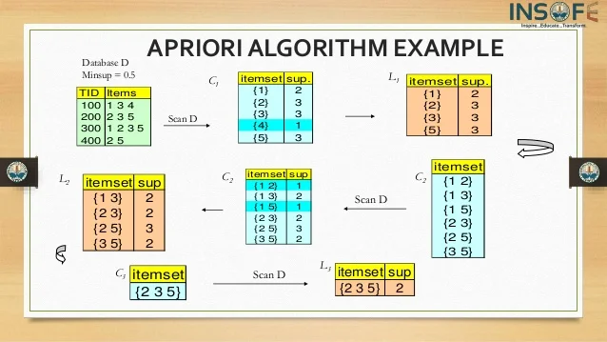
The Apriori Algorithm — Example

